Slide 1
Texture Mapping
Chris Moore
CS 551

Slide 2
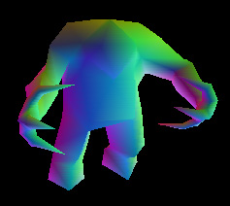
Purpose
Color Shading

Slide 3
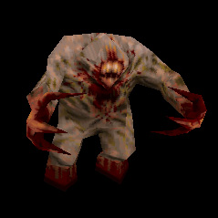
Purpose
Elaborate Surfaces
= Many Polygons

Slide 4
Purpose
Elaborate Surfaces
= Many Polygons
People Wanted More Detail

Slide 5
Solution
Texture Mapping
  Pasting a Picture onto an Object Surface

Slide 6
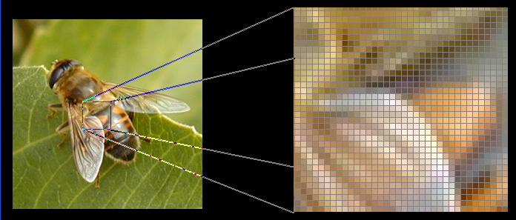
Textures
Pasted Picture = ‘Texture’

Slide 7
Textures
Pasted Picture = ‘Texture’
Pixel of Texture = ‘Texel’

Slide 8
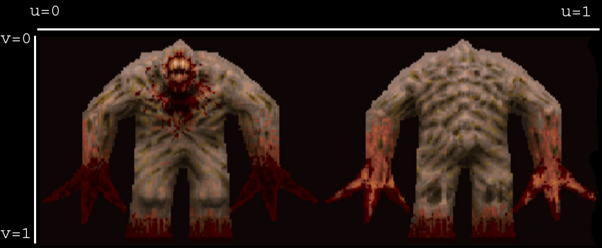
Texture Space

Slide 9
Texture Space
Texture Coordinates

Slide 10
Texture Space
Texture Coordinates
  Represented <u, v>

Slide 11
Texture Space
Texture Coordinates
  Represented <u, v>
  Mapped to [0,1]

Slide 12
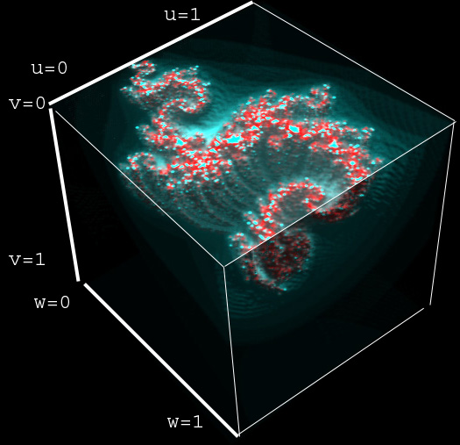
3D Textures

Slide 13
3D Textures
‘Texel’ = Voxel

Slide 14
3D Textures
‘Texel’ = Voxel
Represented <u, v, w>

Slide 15
Mapping Process
Calculate Surface Coordinate <x, y, z>
  Ray Trace Intersection
  Scan Line Interpolation

Slide 16
Mapping Process
Calculate Surface Coordinate <x, y, z>
  Ray Trace Intersection
  Scan Line Interpolation
Use to Compute Texture Coordinates

Slide 17
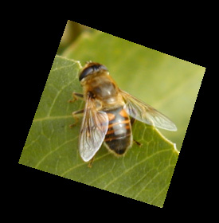
Function Generated

Slide 18
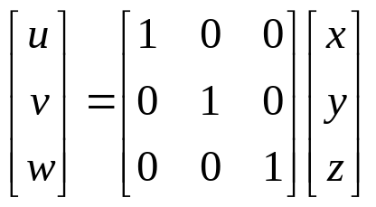
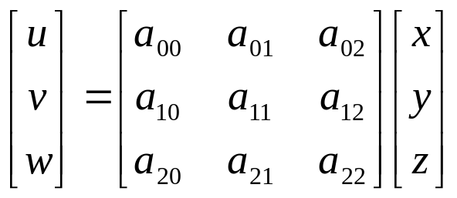
Function Generated
Identity
Linear

Slide 19
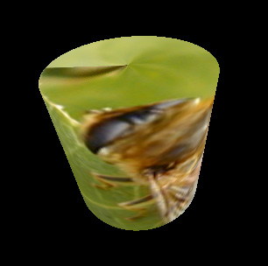
Function Generated

Slide 20
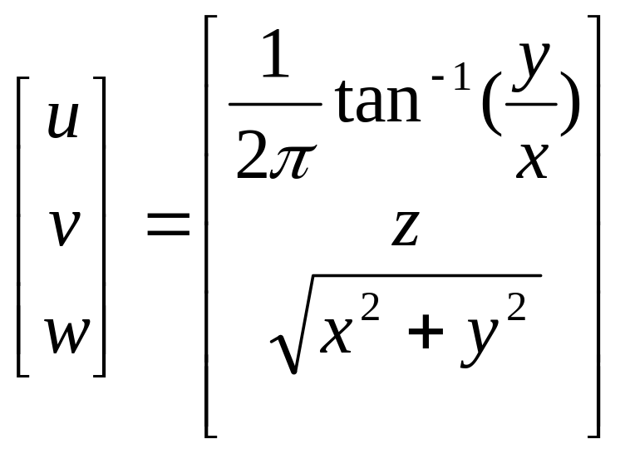
Function Generated
Cylindrical

Slide 21
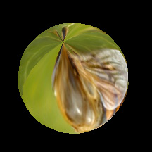
Function Generated

Slide 22
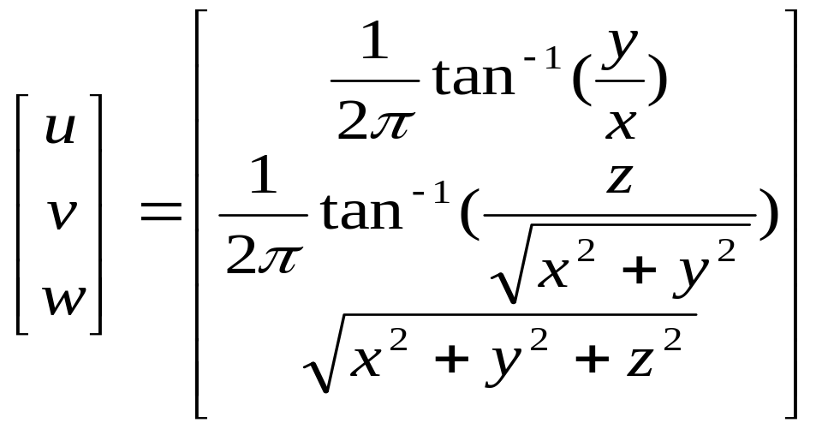
Function Generated
Spherical

Slide 23
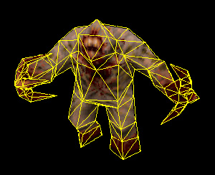
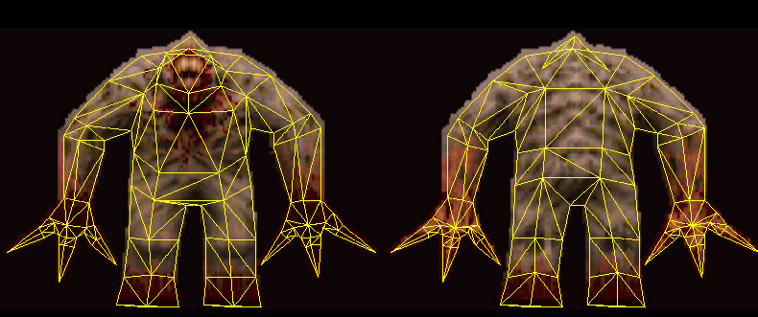
User Specified

Slide 24
User Specified
Assigned at Vertices

Slide 25
User Specified
Assigned at Vertices
Interpolated Between Vertices

Slide 26
User Specified
Assigned at Vertices
Interpolated Between Vertices
Fits Complex Models

Slide 27
User Specified
Assigned at Vertices
Interpolated Between Vertices
Fits Complex Models
Most Commonly Used

Slide 28
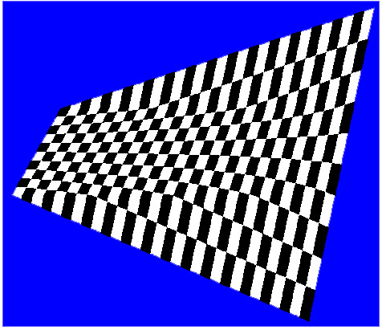
Coordniate Interpolation
Affine
  Interpolate in Screen Space

Slide 29
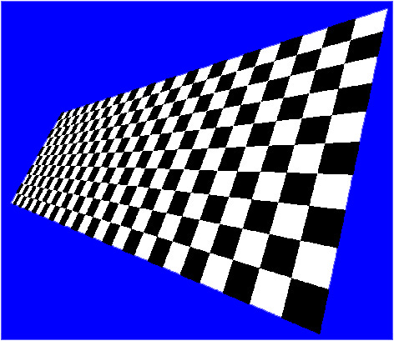
Coordniate Interpolation
Affine
  Interpolate in Screen Space
Perspective
  First Divide by Depth
  Then Interpolate

Slide 30
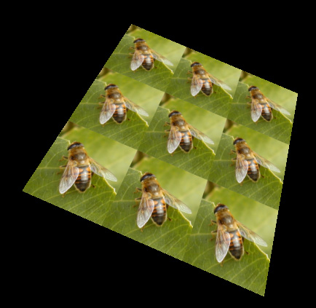
Coordinate Boundaries

Slide 31
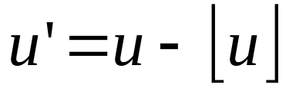
Coordinate Boundaries
Repeat

Slide 32
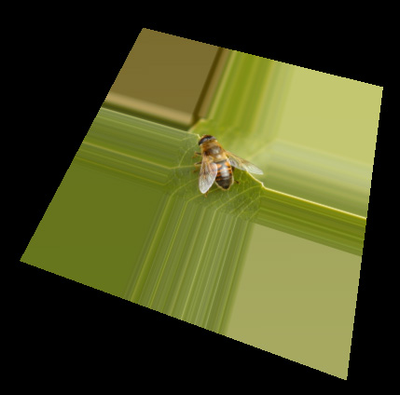
Coordinate Boundaries

Slide 33
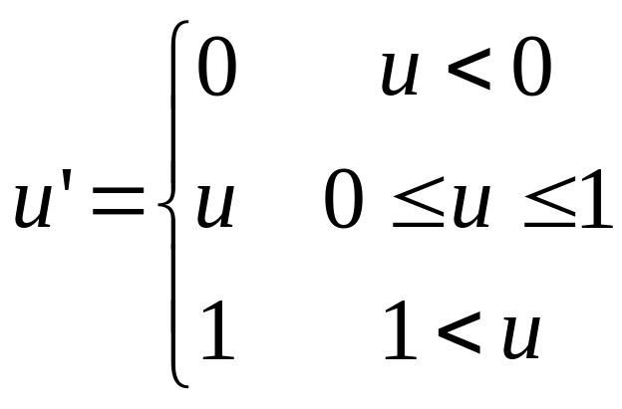
Coordinate Boundaries
Clamp

Slide 34
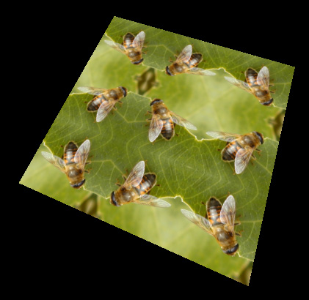
Coordinate Boundaries

Slide 35
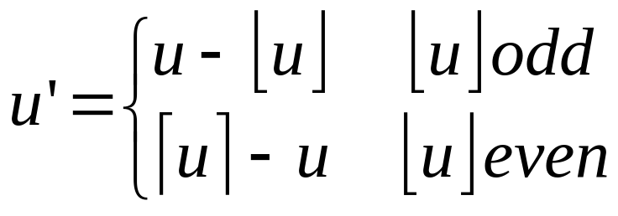
Coordinate Boundaries
Mirror

Slide 36
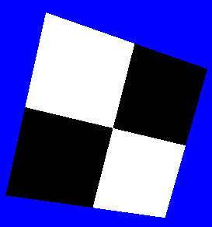
Determining Color
Use Nearest Texel

Slide 37
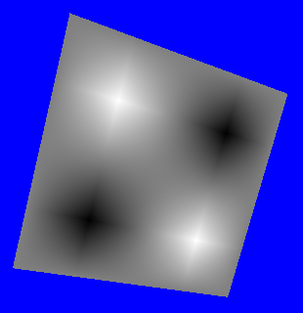
Determining Color
Use Nearest Texel
Interpolate Between Neighboring Texels

Slide 38
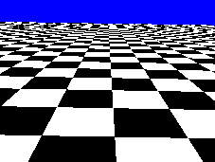
MIP-Mapping
Without
MIP-Mapping

Slide 39
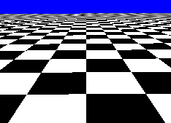
MIP-Mapping
Without
MIP-Mapping
With
MIP-Mapping

Slide 40
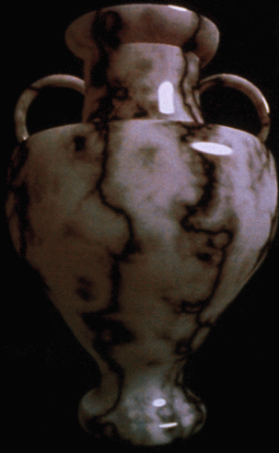
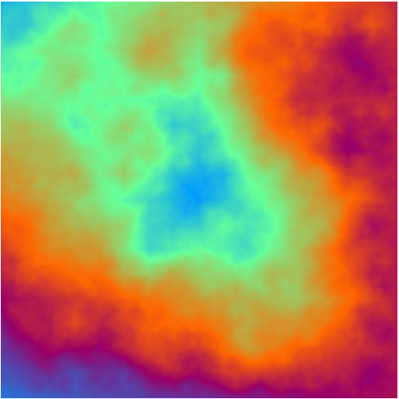
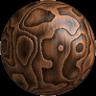
Texture Generation
Fractal Generated
Perlin Noise
Many More

Slide 41
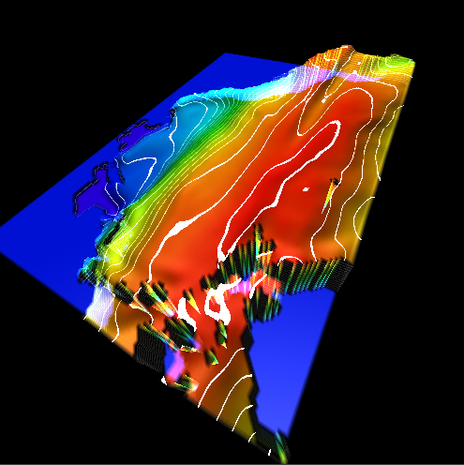
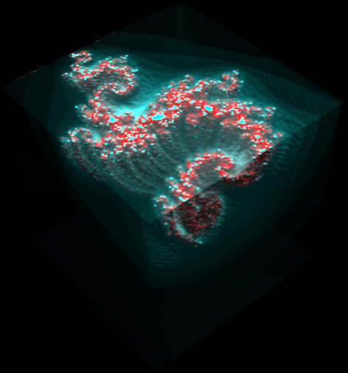
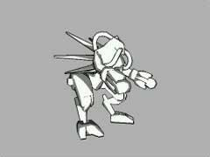
Uses of Textures
Cel Shading
Volume Render
Contour Maps

Slide 42
More Uses of Textures
Color Maps
  Diffuse, Specular
Surface Maps
  Bump, Displacement
Effects
  Transparency
Look-Up Tables
  Volumetric Fog
  Blinn Lighting Model

Slide 43
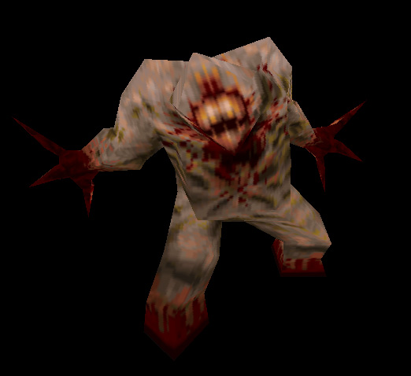
Conclusion

Slide 44
Sources
Plasma Fractal: http://www.ic.sunysb.edu/Stu/jseyster/plasma/
Perlin Vase: http://mrl.nyu.edu/~perlin/doc/vase.html
Perlin Texture: http://freespace.virgin.net/hugo.elias/models/m_perlin.htm
3D Model & Skin: ID Software – http://www.idsoftware.com
Affine / Perspective Textures:
  Paul S. Heckbert, Henry P. Moreton. "Interpolation for Polygon Texture Mapping and Shading” © 1991

